Slide 1
Snacks Squad: Customizable Snacks Ordering and Delivery Android App

Slide 2
DESCRIPTION :
OVERVIEW:
Snacks Squad is an Android app that allows users to order and customize snacks according to their preferences, with fast delivery to their doorstep
KEY FEATURES:
Personalized snack menu with customization options.
Real-time order tracking with notifications.
Secure payment methods like cards, wallets, and cash on delivery.Quick and reliable delivery services.
Subscription plans for regular snack deliveries
TOOLS USED:
Frontend: Android (Java/Kotlin) and XML for UI design.
Backend: Firebase for database and authentication.
Payment Integration: Stripe and PayPal APIs.
Tracking: Google Maps API for real-time delivery tracking..

Slide 3
MAIN ACTIVITY CODE
package com.example.snackordering
import android.annotation.SuppressLint
import android.content.Context
import android.os.Bundle
import androidx.activity.ComponentActivity
import androidx.activity.compose.setContent
import androidx.annotation.DrawableRes
import androidx.annotation.StringRes
import androidx.compose.foundation.Image
import androidx.compose.foundation.background
import androidx.compose.foundation.layout.*
import androidx.compose.foundation.shape.RoundedCornerShape
import androidx.compose.material.*
import androidx.compose.material.icons.Icons
import androidx.compose.material.icons.filled.*

Slide 4
import androidx.compose.runtime.Composable
import androidx.compose.ui.Alignment
import androidx.compose.ui.Modifier
import androidx.compose.ui.draw.clip
import androidx.compose.ui.graphics.Color
import androidx.compose.foundation.lazy.LazyColumn
import androidx.compose.foundation.lazy.items
import androidx.compose.material.Text
import androidx.compose.ui.unit.dp
import androidx.compose.ui.graphics.RectangleShape
import androidx.compose.ui.layout.ContentScale
import androidx.compose.ui.platform.LocalContext
import androidx.compose.ui.res.painterResource
import androidx.compose.ui.res.stringResource
import androidx.compose.ui.text.font.FontWeight
import androidx.compose.ui.unit.sp
import com.example.snackordering.ui.theme.SnackOrderingTheme
import android.content.Intent as Intent1

Slide 5
class MainPage : ComponentActivity() {
override fun onCreate(savedInstanceState: Bundle?) {
super.onCreate(savedInstanceState)
setContent {
SnackOrderingTheme {
// A surface container using the 'background' color from the theme
Surface(
modifier = Modifier.fillMaxSize(),
color = MaterialTheme.colors.background )
{
FinalView(this)
val context = LocalContext.current
//PopularFoodColumn(context) } } } }
} @Composable
fun TopPart() {
Row(
modifier = Modifier 39
.fillMaxWidth()

Slide 6
.background(Color(0xffeceef0)), Arrangement.SpaceBetween
) {
Icon(
imageVector = Icons.Default.Add, contentDescription = "Menu Icon",
Modifier
.clip(RectangleShape)
.size(50.dp),
tint = Color.Black,
) Column(horizontalAlignment = Alignment.CenterHorizontally) {
Text(text = "Location", style = MaterialTheme.typography.subtitle1, color =
Color.Black)
Row {
Icon(
imageVector = Icons.Default.LocationOn,
contentDescription = "Location",
tint = Color.Gray,
) Text(text = "Chennai" , color = Color.Red)
}

Slide 7
Icon(
imageVector = Icons.Default.Notifications, contentDescription = "Notification
Icon",
Modifier
.size(45.dp),
tint = Color.Yellow )
} @Composable
fun CardPart() {
Card(modifier = Modifier.size(width = 310.dp, height = 150.dp),
RoundedCornerShape(20.dp)) {
Row(modifier = Modifier.padding(10.dp), Arrangement.SpaceBetween) {
Column(verticalArrangement = Arrangement.spacedBy(12.dp))
Text(text = "Claim voucher", color = MaterialTheme.colors.surface)
}
}
Image(
painter = painterResource(id = R.drawable.pasta),
contentDescription = "Food Image", Modifier.size(width = 100.dp, height =
200.dp)
)

Slide 8
Modifier
.size(45.dp),
tint = Color.Yellow )
}
@Composable
fun CardPart() {
Card(modifier = Modifier.size(width = 310.dp, height = 150.dp),
RoundedCornerShape(20.dp)) {
Row(modifier = Modifier.padding(10.dp), Arrangement.SpaceBetween) {
Column(verticalArrangement = Arrangement.spacedBy(12.dp)) {
Text(text = "Get Special Discounts")
Text(text = "up to 85%", style = MaterialTheme.typography.h5)
Button(onClick = {}, colors = ButtonDefaults.buttonColors(Color.DarkGray))
}

Slide 9
@Composable
fun PopularFood(
@DrawableRes drawable: Int,
@StringRes text1: Int,
context: Context
) {
Card(
modifier = Modifier
.padding(top=20.dp, bottom = 20.dp, start = 65.dp)
width(250.dp) ) {
Column( verticalArrangement = Arrangement.Top, horizontalAlignment = Alignment.CenterHorizontally
) { Spacer(modifier = Modifier.padding(vertical = 5.dp))
Row(
modifier = Modifier
.fillMaxWidth(0.7f), Arrangement.End
) {
I

Slide 10
Icon( imageVector = Icons.Default.Star,
contentDescription = "Star Icon",
tint = Color.Yellow )
Text(text = "4.3", fontWeight = FontWeight.Black) }
Image( painter = painterResource(id = drawab
contentDescription = "Food Image",
contentScale = ContentScale.Crop,
modifier = Modifier
.size(100.dp)
.clip(RectangleShape) )
Text(text = stringResource(id = text1), fontWeight = FontWeight.Bold)
Row(modifier = Modifier.fillMaxWidth(0.7f), Arrangement.SpaceBetween) le),
/*TODO Implement Prices for each card*/
Text( text = "$50", 42 style = MaterialTheme.typography.h6,
fontWeight = FontWeight.Bold,
fontSize = 18.sp
)

Slide 11
IconButton(onClick = {var no=FoodList.lastIndex
val intent = Intent1(context, TargetActivity::class.java)
context.startActivity(intent) }) {
Icon( imageVector = Icons.Default.ShoppingCart,
contentDescription = "shopping cart", ) }}}}
private val FoodList = listOf(
R.drawable.burger to R.string.burgers,
R.drawable.pack to R.string.pack,
R.drawable.salad to R.string.salad,
R.drawable.popcorn to R.string.popcorn
).map { DrawableStringPair(it.first, it.second) }
private data class DrawableStringPair(
@DrawableRes val drawable: Int,
@StringRes val text1: Int
) @Composable
fun App(context: Context)

Slide 12
{ Column( modifier = Modifier
.fillMaxSize()
.background(Color(0xffeceef0))
.padding(10.dp),
verticalArrangement = Arrangement.Top,
horizontalAlignment = Alignment.CenterHorizontally
) { Surface(modifier = Modifier, elevation = 5.dp) {
TopPart() }
Spacer(modifier = Modifier.padding(10.dp))
CardPart()
Spacer(modifier = Modifier.padding(10.dp))
Row(modifier = Modifier.fillMaxWidth(), Arrangement.SpaceBetween) {
Text(text = "Popular Food", style = MaterialTheme.typography.h5, color =
Color.Black)
Text(text = "view all", style = MaterialTheme.typography.subtitle1, color =
Color.Black) }

Slide 13
Spacer(modifier = Modifier.padding(10.dp))
PopularFoodColumn(context) // <- call the function with parentheses }}
@Composable
fun PopularFoodColumn(context: Context) {
LazyColumn( modifier = Modifier.fillMaxSize(),
content = {
items(FoodList) { item ->
PopularFood(context = context,drawable = item.drawable, text1 = item.text1)
abstract class Context } },
verticalArrangement = Arrangement.spacedBy(16.dp)) }
@SuppressLint("UnusedMaterialScaffoldPaddingParameter")
@Composable
fun FinalView(mainPage: MainPage) {
SnackOrderingTheme {
Scaffold() {
val context = LocalContext.current
App(context) } } }

Slide 14
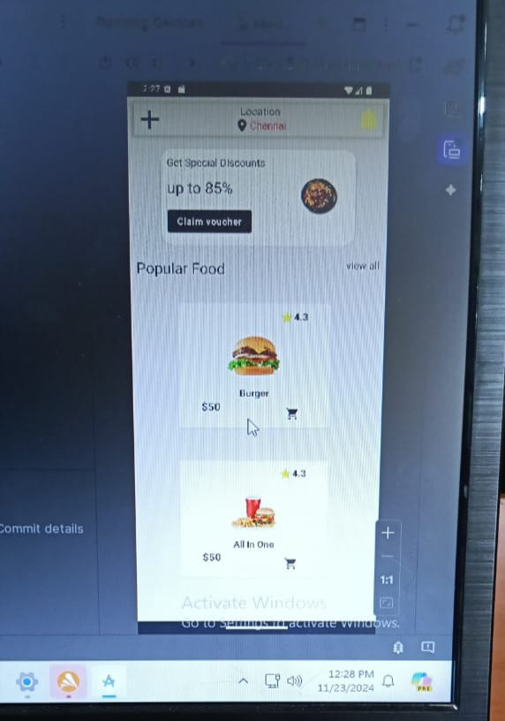
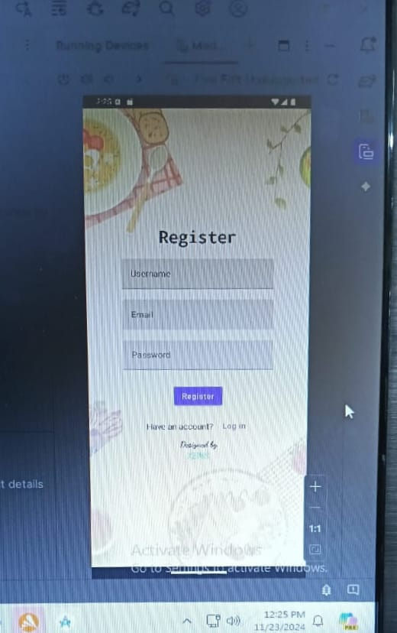
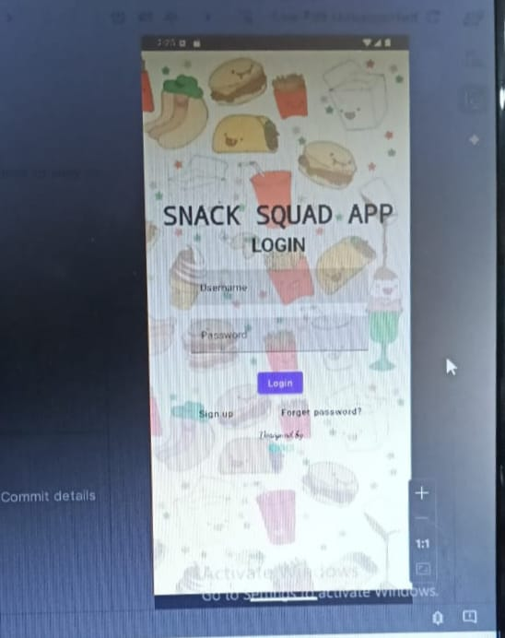
0UTPUT

